Slide 1
Long-Distance Digital Connection Technologies

Slide 2
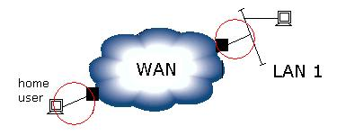
Objective

Slide 3
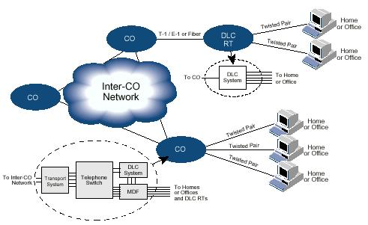
Existing Telephone Infrastructure (1)
CO =Central Office, RT = Remote Terminal, DLC = Digital Loop Carrier; MDF = Main Distribution Frame

Slide 4
Existing Telephone Infrastructure (2)
Why Digital Telephony?
Analog signals, the mechanism used in early telephone systems had problems in a long distance environment. Because electrical signals degrade as they pass over copper wires. Amplifiers boosting the signals distorts the original signals and introduces noise.
Digital communication avoids the problem of noise by encoding the original audio signal into digital form.

Slide 5
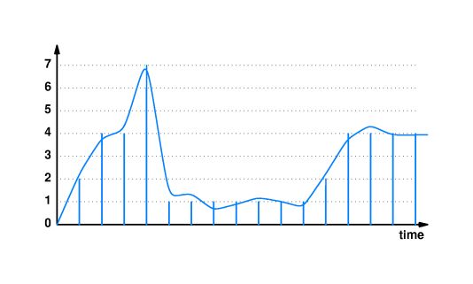
Existing Telephone Infrastructure (3)
Digitization (A-to-D converter)

Slide 6
Existing Telephone Infrastructure (4)
PCM (Pulse Code Modulation)
PCM is a standard for digital encoding of audio used in the telephone system.
PCM samples a signal once every 125µ seconds and converts each sample into an integer between 0 and 255.

Slide 7
Existing Telephone Infrastructure (5)
Synchronous Communication
The facilities used for digital voice differ from the systems used for data because voice systems use synchronous or clocked technology, while most data networks use asynchronous technology.
A synchronous network consists of a system designed to move data at a precise rate.

Slide 8
Digital Circuits and DSU / CSUs
Digital circuits leased from common carriers form the fundamental blocks for long distance computer networks.
Each circuit extends between two specified points and the fee depends on the circuit capacity and distance.
A digital circuit needs a device known as a DSU/CSU at each end.
In addition to terminating the line, the DSU/CSU translates between the digital representation used by phone companies and the digital representation used by the computer industry.

Slide 9
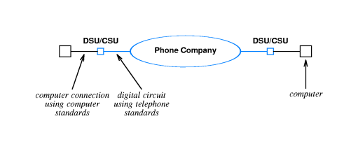
Digital Circuits and DSU / CSUs

Slide 10
Digital Circuits and DSU / CSUs
CSU
Carries out diagnostics
Accommodate current surges
Checking the CSUs at the other end
Performs bit stuffing or balanced encoding scheme
DSU
Translates data between the digital format used on the carrier’s circuit and the digital format required by the customer’s computer equipment.

Slide 11
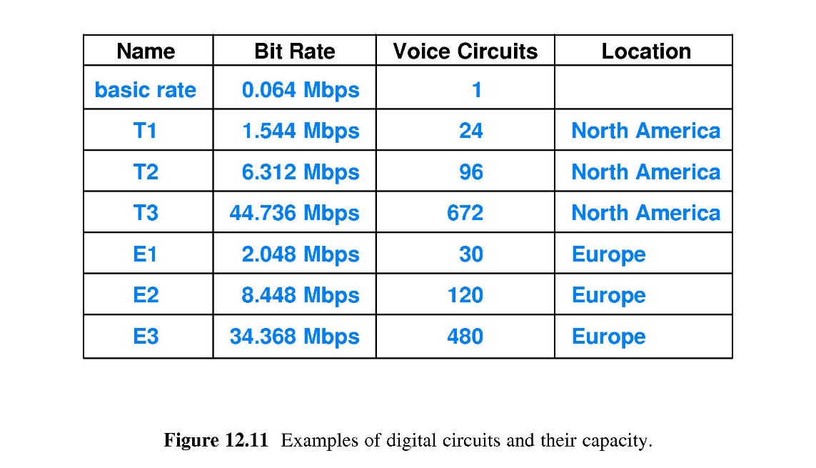
Telephone Standards

Slide 12
DS Terminology And Data Rates
T (or E ) standards define the underlying carrier system.
Multiplexing multiple phone calls on a single connection is defined by DS (Digital Signal Level) standard.

Slide 13
Lower Capacity Circuits
A company does not need T1 capacity can save money by leasing a fractional T1 digital circuit.
The phone company uses TDM to subdivide a T1 circuit.

Slide 14
Intermediate Capacity Circuits
What if the company needs a circuit with slightly more than T1 capacity, but only T3 circuits are available?
Inverse Multiplexing technology allows one to lease multiple T1 circuits between two points and use them as a single higher capacity circuit.

Slide 15
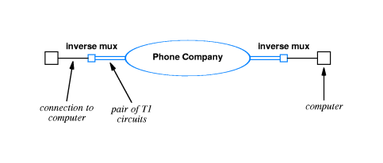
Inverse Multiplexing for Intermediate Capacity Digital Circuits
Inverse Multiplexer devices may have built-in DSU / CSU functionality.

Slide 16
Highest Capacity Circuits
SONET/SDH Designations and bandwidths
SONET Optical Carrier level | SONET frame format | SDH level and frame format | Payload bandwidth (kbit/s) | Line rate (kbit/s) | Voice Circuits
OC-1 | STS-1 | STM-0 | 50,112 | 51,840 | 810
OC-3 | STS-3 | STM-1 | 150,336 | 155,520 | 2,430
OC-12 | STS-12 | STM-4 | 601,344 | 622,080 | 9,720
OC-24 (*) | STS-24 | – | 1,202,688 | 1,244,160 | 19,440
OC-48 | STS-48 | STM-16 | 2,405,376 | 2,488,320 | 38,880
OC-192 | STS-192 | STM-64 | 9,621,504 | 9,953,280 | 155,520
OC-768 | STS-768 | STM-256 | 38,486,016 | 39,813,120 | 622,080
(*): OC-24 is standardized in ANSI T1.105, but not a SDH standard rate in ITU-T G.707

Slide 17
Synchronous Optical Network
In addition to STS and OC standards SONET brings some other standards
Specifies how data is framed
Specifies how lower capacity circuits are multiplexed
Provides transmission of clock information along with data

Slide 18
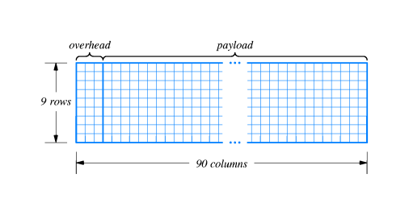
Synchronous Optical Network
Synchronous Digital Hierarchy
STS1 : 6480 bits (810 octets) are transferred at every 125µ seconds
STS3 : 2430 octets are transferred at every 125µ seconds

Slide 19
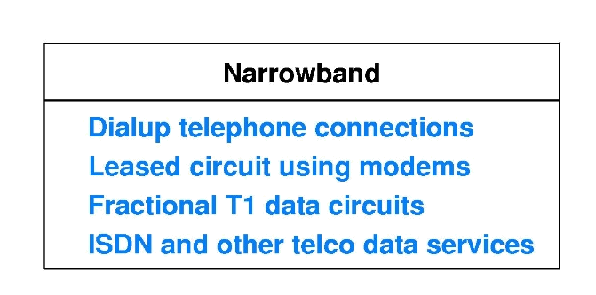
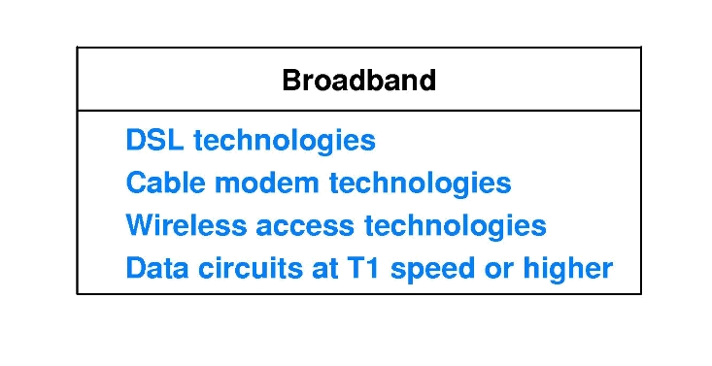
Internet Connection Technologies

Slide 20
The Local Subscriber Loop
Connection between telephone company central office and an individual subscriber’s residence or place of business.
The term adopted to refer to the connection from network provider to individual subscriber.

Slide 21
Integrated Services Digital Network (ISDN)
Uses existing wiring and provides digitized voice or data.
ISDN offers three different digital channels: B, B, and D (2B+D).
B (bearer, 64Kbps) channels are intended to carry digitized voice or data, D (data, 16 Kbps) channels support signaling for the B-channel and is capable of carrying packet data.
B channels can be combined (bonded).
2B+D are known as the ISDN Basic Rate Interface (BRI).

Slide 22
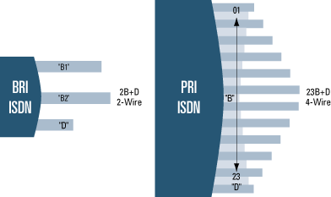
ISDN BRI and PRI

Slide 23
DSL Technologies
DSL refers to the technology used between a customer's premises and the telephone company, enabling more bandwidth over the already installed copper cabling than users have traditionally had.
xDSL is a generic abbreviation for the many flavors of DSL or Digital Subscriber Line technology.

Slide 24
DSL Technologies (cont’d)
Go beyond the 4,000 Hz frequency boundary to provide more bandwidth.
Elimination of 4,000 Hz boundary is theoretically possible but in practice, some limitations which arise from physical media must be taken into consideration.
  Attenuation
  Crosstalk
  Bridge taps

Slide 25
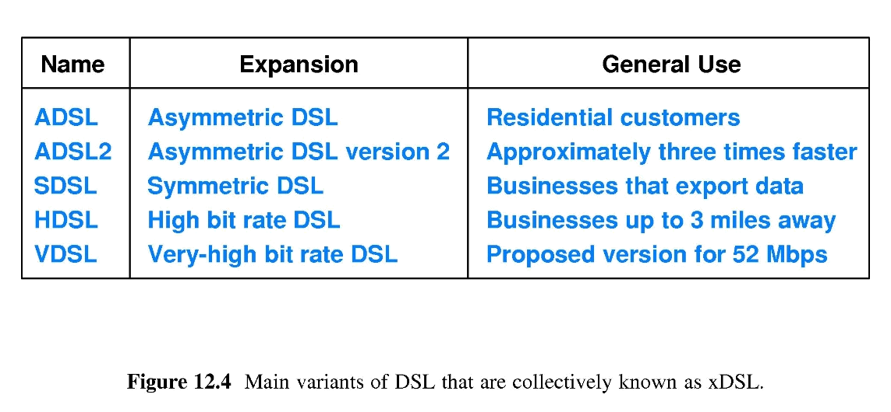
Common DSL Types

Slide 26
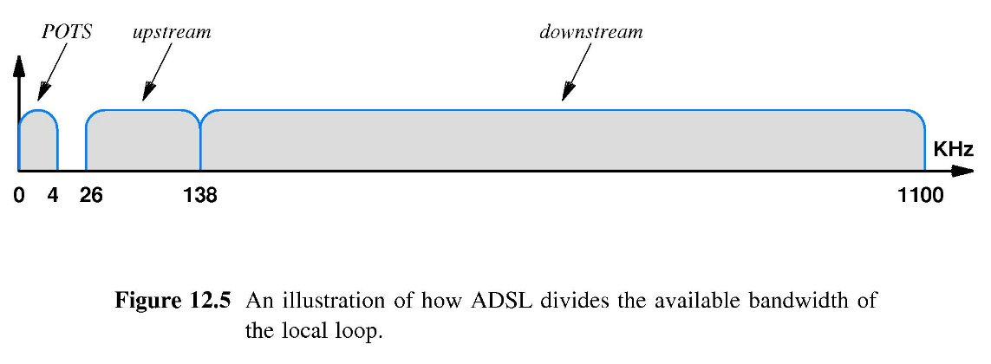
Asymmetry in DSL Technology
You can more reliably transmit a higher-speed signal from the CO to the remote location than can be transmitted from the remote location to the CO.

Slide 27
Asymmetric DSL (ADSL)
Theoretically provides 8,448 Mbps maximum downstream rate, 640 Kbps maximum upstream rate.
ADSL2 can download 20 Mbps (under the best conditions)
ADSL is adaptive:When ADSL modems are powered on, they probe the line between them to discover the characteristics of the line and select the optimal frequencies and modulation techniques.
286 subchannels; 31 upstream, 255 downstream
2 of the upstream channels are reserved for control information.

Slide 28
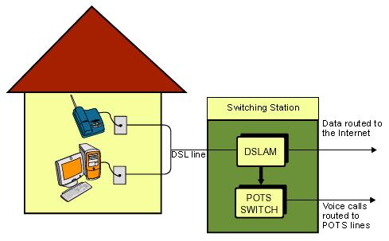
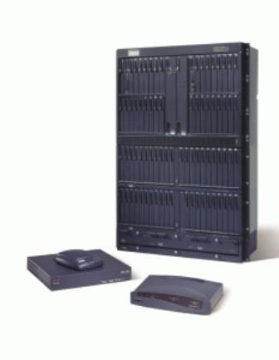
DSL Connection

Slide 29
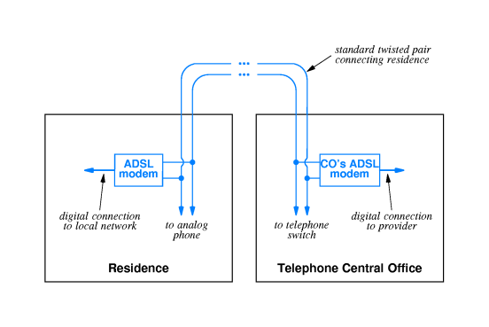
ADSL

Slide 30
HDSL
HDSL (HIGH-BIT-RATE DIGITAL SUBSCRIBER LINE):
High-bit-rate Digital Subscriber Line (HDSL) technology is a transparent replacement for a T-1 repeatered line in the distribution plant.
It allows DS-1 (service that multiplexes 24 phone calls (1.544 Mbps data rate) onto one circuit) signals to be transported over distances of up to 3.7 km on copper cable without line repeaters.

Slide 31
SDSL
Single-pair implementation of T1 or E1 HDSL is referred to as Symmetric Digital Subscriber Line (SDSL).

Slide 32
VDSL
VDSL (VERY HIGH SPEED DSL):
The newest emerging variant of DSL is VDSL, or Very High Speed DSL.
VDSL systems are still being developed so the final capabilities are not yet firmly established, but proposed standards call for downstream bandwidths of up to 52 Mbps and symmetric bandwidths of up to 26 Mbps.
The tradeoff to these bandwidths is a much shorter loop reach, often as short as 300 m for the highest possible bandwidths.

Slide 33
Cable Modem Technology
Engineers have devised ways to use the existing cable TV (Communly Antenna Television infrastructure) as a local loop technology that delivers digital data to subscribers.
In theory it’s possible to use FDM for each user. But for millions of users it is very difficult to dedicate a separate frequency to each individual.
Instead cable supplier provides separate frequencies to sets of subscribers and TDM is used to subdivide each channel.

Slide 34
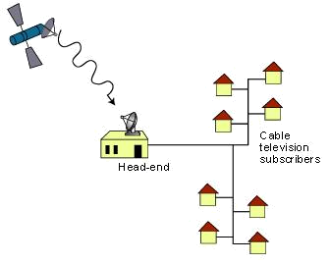
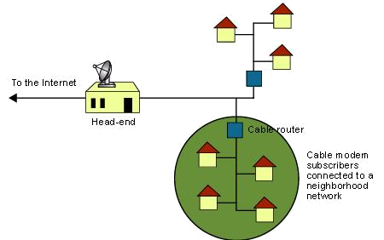
Cable TV Neighborhood

Slide 35
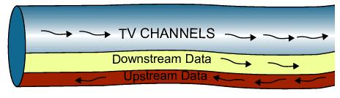
Cable Modem Technology (cont’d)
Upstream Communication
Because the original cable infrastructure only provided downstream delivery, the original system could not be used to provide two-way digital communication.

Slide 36
Hybrid Fiber Coax
To use Hybrid Fiber Coax, cable companies must change much of the central infrastructure.
Trunk lines must be replaced with fiber and all amplifiers must be modified to operate in both directions.
However the system can use existing coax feeder circuits to reach individual subscribers.

Slide 37
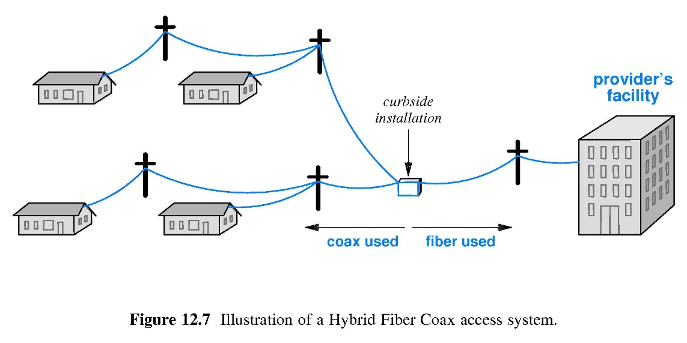
Hybrid Fiber Coax (illustration)

Slide 38
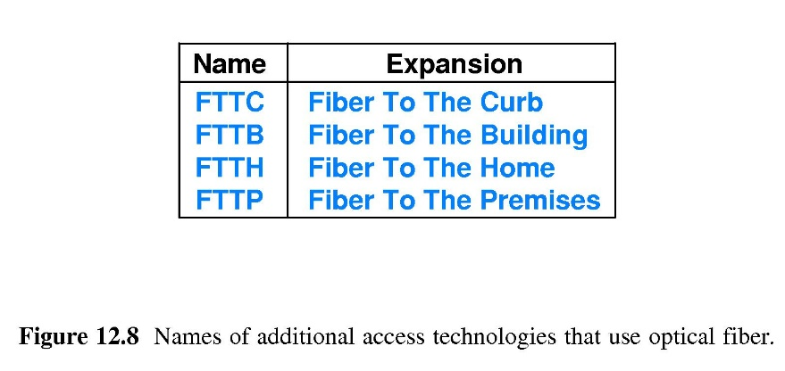
Accesss Technologies that Employ Optical Fiber

Slide 39
Fiber to the Curb
Optical fiber is used to allow high upstream data rates.
İt is similar to HFC (Hybrid Fiber Coax)
Fiber cable is run close to the subscriber, the copper is used for the feeder circuits.
It uses two media in each feeder circuit to provide additional services (such as voice).

Slide 40
Fiber to the Building/Home/Premises
FTTB:
  Optical connection is close to the subscriber.
  Both coaxial cable (for CATV) and twisted pair (for data networking) is extended to subscribers.
FTTH:
  Higher Downstream data rates can be achieved.
  Many channels of Entertainment and video.
FTTP:
  Generic term.
  Encompasses both FTTB and FTTH.

Slide 41
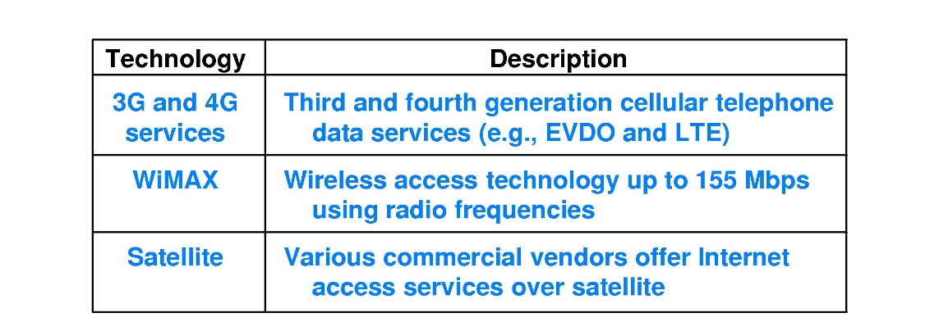
Wireless Alternatives
IEEE developed 802.16 Standard
It has a throughput up to 155 Mbps
The name of the technology is WiMAX
WiMAX is classified as MAN
WiMAX can be used as a local loop replacement or as a technology that provides higher speed access between a neighbourhood and a central office

Slide 42
Broadcast Satellite Systems
Use air as a shared medium
Instead of using satellites as a point to point communication systems a broadcast mechanism was devised.
Instead of a large, expensive ground station, an alternative uplink transmission path was used.

